Slide 1
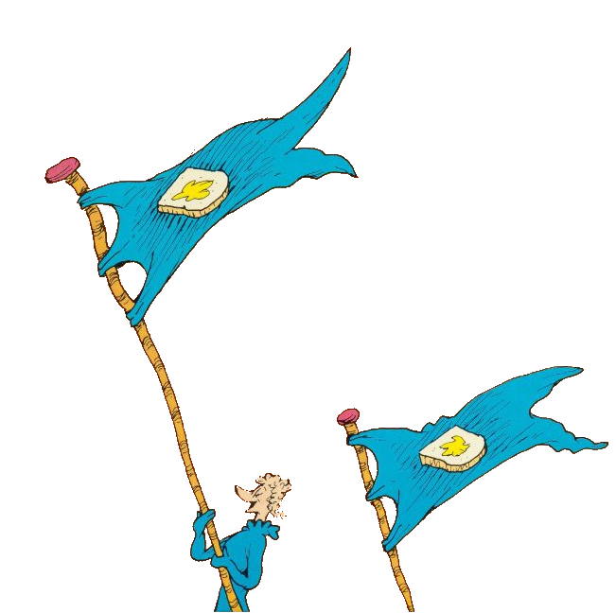
Tolerance:
The ability or willingness to tolerate something, in particular the existence of opinions or behavior that one does not necessarily agree with. This means you accept others who are different in their race, culture, habits, and their beliefs. Too often people don’t get along, because of their differences. People may like different types of music, they may like different sports, foods, style of clothing, they may look differently, or have different political views. Although people may be different in many ways, we still have many things in common. We must learn
to get along and tolerate each other. We must find peaceful ways to work through our problems instead of using violence. No one truly wins when violence is used, and we are reminded of this in Dr. Seuss’ “The Butter Battle Book.” Listen to the story and think of how the Zooks and the Yooks could have demonstrated tolerance and solved their problems.

Slide 2
Click here to hear
“The Butter Battle Book” by Dr. Seuss
www.schooltube.com/media/The+Butter+Battle+Book+by+Dr.+Seuss/1_oyiraoyv

